Slide 1

Welcome to
The Session Will Begin Shortly
Notes:
Hello, everyone. Can you send me a private message in Zoom if you do not have R and RStudio installed? If you do have them both installed, give this message a thumbs up. This will help me determine when I should be getting the package installs going in our first hour. Thanks!

Slide 2
START
Notes:
Add time table for session and break, summary of what’s to come, house rules, learning objectives at the start and end, Q&A before STOP
If question is taking too long, direct to forum or consultancy if too sensitive. While you are welcome to ask questions on how things might apply to your particular work, I encourage you to think about the specific examples carefully as I go through them.

Slide 4
Statistics in R with Tidyverse
Session 1: Introduction to R and RStudio
Notes:
Welcome to Session 1 of 12 sessions making up a 12-hour course on Statistics in R with the tidyverse. Over our time together, you'll unlock the power of R to transform raw data into compelling insights. Through hands-on practice, you'll master data wrangling with the tidyverse, create stunning visualizations with `ggplot2`, and apply statistical inference with ease using the `infer` package. You'll also build and interpret regression models with `moderndive`, blending both theory-based and simulation-based approaches to tackle real-world data challenges with confidence.
If you have any questions, please direct them to the Zoom chat first. I want this to be as interactive as possible, so please keep your questions coming. I have time blocked off for Q&A at the end of each of our sessions too. I asked that you keep your microphones muted as well unless you and I are conversing.
Before we dive in, let me tell you a little bit about myself.

Slide 5
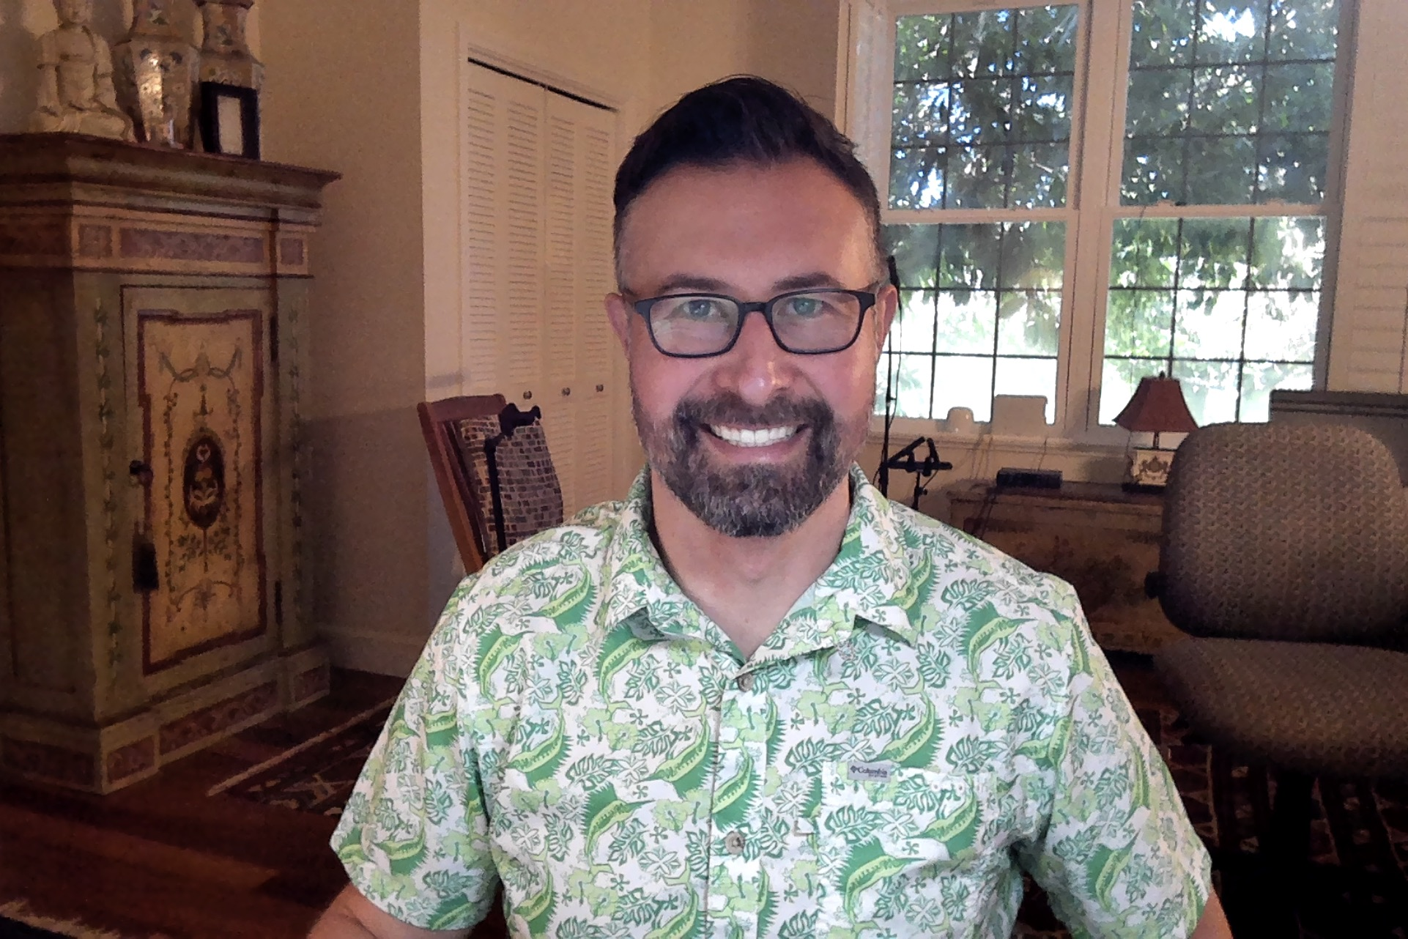
Welcome and Introduction
Dr. Chester Ismay
• PhD in Statistics
• Worked in academia, online education, corporate training, tech bootcamps, and independent consulting
• Currently,
• Faculty Member in Data Analytics,
Portland State University
• Vice President of Data and Automation,
MATE Seminars
• Freelance data scientist and educator
• Fun Fact: Slept a night or eaten a meal in all 50 US states
Notes:
Consulted for state lotteries, the Portland Trail Blazers, actuarial firms, major universities,
Also never met another person named Chester or Chet
I want to tell you a little bit about me too. I grew up in a town of 114 people in western South Dakota. After completing my PhD at Arizona State University in 2013, I was a statistics and computer science professor at Ripon College in central Wisconsin for a few years. (Quite the change in temperatures for sure!) I also worked at Reed College as an adjunct professor and data consultant for the college in Portland, Oregon. I further had the opportunity to work with the sports scientist of the Portland Trailblazers NBA team on analyzing some of their team data with R. I’ve also worked in online education, corporate training, and up until December of last year I was Senior Director of Data Science Education at Flatiron School. I’m now a freelance data consultant living in Phoenix, Arizona as well as Vice President of Data and Automation at MATE Seminars and a faculty member virtually at Portland State University. I’m an avid basketball fan, and I’ve picked up playing pickleball as well over the last few years.
I’ve been working with R pretty much every day since 2015 and have found a lot of joy in automating many of the manual tasks that I need to perform and also improving as a programmer. I’m the author of a couple R packages too that we will work with in this course. I co-authored a textbook called “Statistical Inference via Data Science: A ModernDive into R and the tidyverse.” It’s designed for people brand new to programming and I used it with my college students in its early stages back in 2017. We just wrapped up the second edition of the book as well with some updated datasets and additional functionality discussed. The book is available online for free at https://moderndive.com/v2/ and will be published in print by CRC Press in early 2025.
The book is the driver for this course as well! Let’s dig into what you’ll learn in our 12 hours together.

Slide 6
Course Learning Objectives
By the end of this course, you will be able to
Perform data wrangling techniques in R via the tidyverse
Develop skills in data visualization with ggplot2
Apply fundamental concepts of statistical inference with infer
Build and interpret regression models with moderndive
Integrate Theory-Based and Simulation-Based Approaches
Notes:
I really like to teach via analogy, so I’ll try to relate many of the topics throughout the course to things that hopefully relate to your day-to-day life. Here are five learning objectives that summarize the content of this 12-hour course covering the content from ModernDive Second Edition:
1. **Perform Data Wrangling Techniques in R:** Think of data wrangling like organizing a messy closet. You take a jumble of clothes (your raw data), sort them by type, size, and season (filter, group, and reshape), and neatly store them in labeled drawers (tidy data format) so you can easily find what you need later for analysis.
2. **Develop Skills in Data Visualization with ggplot2:** Creating data visualizations is like painting a picture. The data is your canvas, and the ggplot2 tools are your paintbrushes. By selecting the right colors, shapes, and patterns, you craft a picture that tells a clear, compelling story that anyone can understand at a glance.
3. **Apply Fundamental Concepts of Statistical Inference:** Comprehend the principles of statistical inference, including the Central Limit Theorem, confidence intervals, and hypothesis testing. Use these techniques to draw conclusions about populations based on sample data. Statistical inference is like making a prediction about the entire forest based on just a few trees. By carefully studying the sample (the trees), you can estimate what the whole forest looks like (the population) and make educated guesses about its overall characteristics.
4. **Build and Interpret Regression Models:** Learn to construct both simple and multiple linear regression models, interpret the coefficients, evaluate model fit, and understand the relationships between variables. Apply these models to real-world datasets to predict outcomes and analyze trends. Building a regression model is like drawing a map between two locations. Each variable is a road on your map, and understanding each’s partial slope and intercept helps you navigate the terrain of relationships between variables, allowing you to predict how one change leads to another.
5. **Integrate Theory-Based and Simulation-Based Approaches:** Differentiate between theory-based methods and simulation-based approaches for statistical analysis, including permutation tests and bootstrapping techniques. Understand when and how to apply each method using the `infer` package to strengthen statistical conclusions. Using theory-based methods is like following a trusted recipe—precise and structured—while simulation-based methods, like permutation tests or bootstrapping, are more like improvising in the kitchen. Both approaches can help you create a delicious result, but you’ll need to know when to stick to the recipe and when to experiment.

Slide 7
Agenda
Day 1: Working with Data in R - Explore, Visualize, Wrangle, Import
Session 1: Introduction to R – Basics and Advanced Techniques
Session 2: Data Visualization using ggplot2
Session 3: Data Wrangling and Tidy Data
Notes:
Now that we’ve outlined some of the key skills you’ll be developing throughout this course, let’s break it down into our Day 1 roadmap. We will plan to spend about 45 minutes to an hour in each of the three sessions today for Day 1 of our four day course. We’ll plan to take a five minute break at the end of each session. We'll start by building a solid foundation in R, move into powerful visualization techniques with ggplot2, and then learn to manipulate and organize data with wrangling techniques to prepare it for deeper analysis.
I’ve designed the course for me to start each session with a high level overview of the session topics with slides and analogies. You can find a PDF of each session’s slides on Instats as a PDF. You’ll also find a Quarto file for each day saved as a .qmd file under Program Files that contains a structure for us to fill in R code and interpret its results. I’ve also added in some multiple choice review questions at the end of each session to check your understanding of the material covered. Each day also has an Exercises file to allow you to further practice your learning between now and the next day of class.
Let’s dive into learning about R and RStudio.

Slide 8
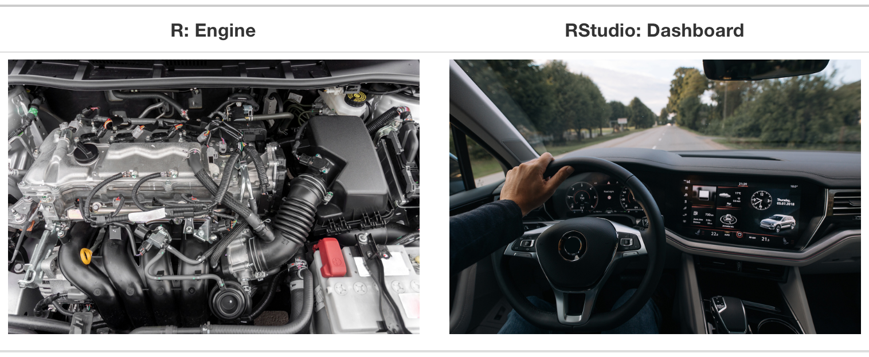
Introduction to R and RStudio
• R: programming language mainly for statistical computing and data analysis • RStudio: IDE • R vs RStudio
Notes:
<SLIDE 1: Introduction to R and RStudio>
- R is a programming language for statistical computing and data analysis.
- RStudio is an Integrated Development Environment (IDE) for working with R.
- R is like the engine of a car, and RStudio is the dashboard that makes it easier to use.
- In this course, we will assume you're using R through RStudio. I’ll be sharing my screen with RStudio running R for each of our session’s walkthroughs.

Slide 9
Installing R and RStudio
• R: https://cloud.r-project.org/ • RStudio: https://posit.co/download/rstudio-desktop/ • Download and install for your operating system
Notes:
- Install R from <https://cloud.r-project.org/> (install R first).
- Windows, macOS, and Linux have specific installation instructions.
- Install RStudio from <https://posit.co/download/rstudio-desktop/>
- RStudio provides features like project management, code environment status, and code visualization.

Slide 10
Coding in R
• Commands entered as code in the Console or via scripts. • Key concepts include objects, vectors, and data types • Conditional statements and functions help perform tasks
• Learning to code takes frequent practice, but it is one of the most rewarding things you can do!
Notes:
- In R, think of the console as your command center where you send instructions to R to make things happen—like a conductor directing an orchestra.
- You’ll work with "building blocks" like objects and vectors, where data types like integers and characters are the materials you’ll shape into meaningful structures.
- Conditional statements and functions act like decision-makers and problem solvers, helping you automate tasks and make your code smarter.
- Coding is a skill you build through repetition—like learning an instrument or a foreign language, the more you practice, the more fluent and creative you become in R. There will be hiccups along the way, but much like you can’t build muscles sitting on the couch, it will take some effort and debugging to build your skills and R muscles.
Now that we’ve covered the basics of how R works, let’s talk about how to unlock its full potential. R becomes even more powerful when you tap into its vast ecosystem of packages—each one like a specialized toolkit. In the next slide, we’ll explore how you can easily extend R’s capabilities by installing and using these packages to handle everything from data wrangling to visualization.

Slide 11
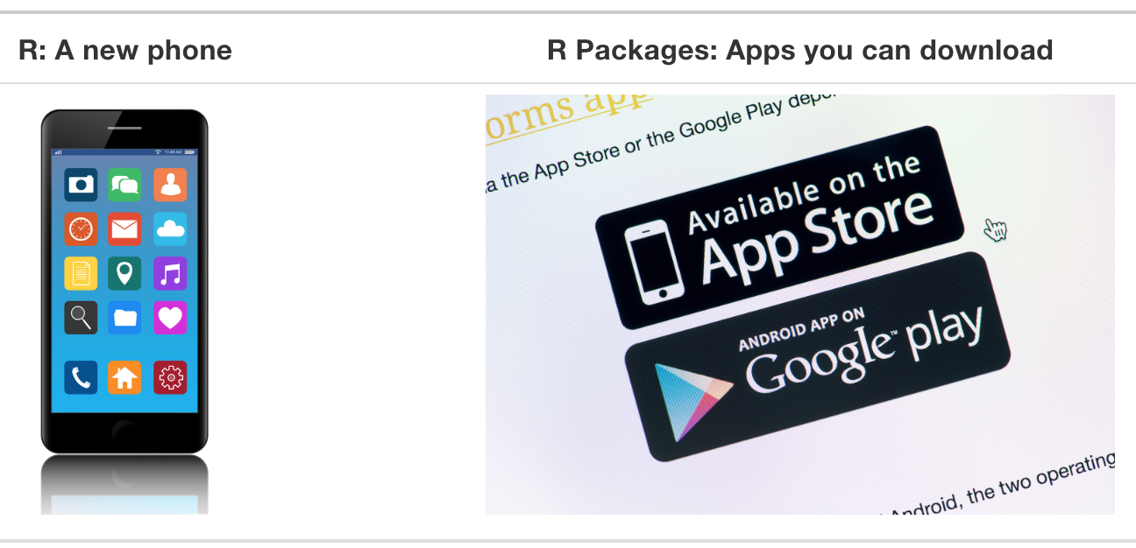
Using R packages
• Extend R’s capabilities with additional functions and/or datasets
• First install the package with install.packages()
• Load the package using library()
Notes:
- R packages are like bonus packs, boosting R’s power with extra functions and preloaded datasets, ready to supercharge your analysis.
- Want to unlock those features? Simply install a package with `install.packages()`—it’s like adding a new tool to your R toolbox or installing a new app on your smartphone
- Once installed, activate your package with `library()` each session, like flipping the switch to start using its specialized functions.
- Game-changers like the `ggplot2` package help you craft stunning visuals, while `dplyr` streamlines your data wrangling workflow with just a few commands. It works to ply your data part using R, hence, dplyr.
Now that you’ve got the tools in hand with R and its packages, let’s turn our attention to the data itself. Just like any good analysis, we need to understand the structure and content of our data before diving deeper. In R, data frames are the go-to format, and here’s how we’ll explore and work with them.

Slide 12
Exploring Data in R with RStudio
• Data frames are like tables with rows and columns
• Use View(), glimpse(), or kable() to inspect
• The $ operator extracts columns from data frames
• Identification versus measurement variables/columns
Notes:
- Think of data frames as R’s version of a spreadsheet—rows and columns neatly organized to store your data.
- To get a quick peek under the hood, use tools like `View()`, `glimpse()`, or `kable()` to inspect and explore your data in different ways.
- Want to grab a specific column? The `$` operator is your shortcut for pulling out exactly what you need, like a key that unlocks individual data pieces.
- Remember, not all columns are alike: some identify rows in your data (like IDs), while others measure it (like height or weight), and it’s important to know the difference.
Let’s next put these ideas into action. We’re going to fire up RStudio and dive into a real-world dataset—the 2023 Stack Overflow survey of data professionals. This will give us hands-on experience working with data frames, exploring variables, and applying some of the tools we just covered. Let’s get started!

Slide 13
Demo & Exercises
Notes:
Before we dive in to the code walkthrough demo, let me orient you to where you’ll find the files necessary for today

Slide 14
Q & A
Notes:
Add time table for session and break, summary of what’s to come, house rules, learning objectives at the start and end, Q&A before STOP
If question is taking too long, direct to forum or consultancy if too sensitive. While you are welcome to ask questions on how things might apply to your particular work, I encourage you to think about the specific examples carefully as I go through them.

Slide 16
STOP

